Slide 1
Hash
Il-Chul Moon Dept. of Industrial and Systems Engineering KAIST
icmoon@kaist.ac.kr

Slide 2
Weekly Objectives
This week, we study the hash table
Objectives are
Understanding why we use hash tables
Understanding the structure and the operation of hash tables
Hash functions
Modulo based hash function
Square based hash function
Digit based hash function
Insertion
Chaining
Open addressing
Linear probing
Quadratic probing
Deletion
Understanding the performance of hash tables

Slide 3
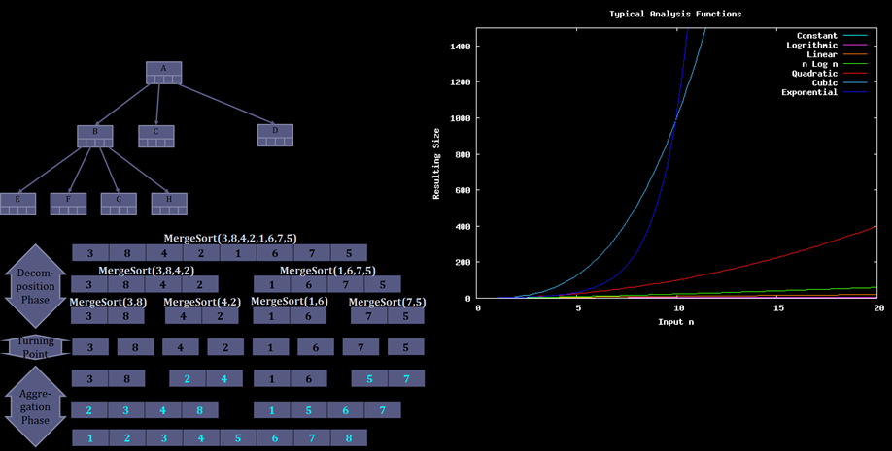
Limit of divide and conquer
The limitation of divide and conquer
If the divide and conquer is based upon a comparison
The efficiency is limited to the logarithm of the problem size
Search: O(N) → O(logN)
Sorting: O(N²) → O(NlogN)
Binary Search Tree
O(log N)
Merge-sort
O(Nlog N)
What-if O(1)?
You can’t achieve this through comparisons…

Slide 4



Cheap storage cost and expensive time cost
Searching and sorting without comparisons…
Because time is gold
With cheap storage spaces, memory and disk
Let’s imagine that we are storing the information of the whole population of Korea
About 50,000,000 individuals
Are they uniquely identifiable?
Yes, by the registration number system
Similarly, bank accounts are identifiable by account numbers
Then, why not store the individual’s information in
A dictionary in Python
Key and value
Key: registration numbers?
Value: my information…
Unlimited storage space?
Probably not….
Dictionary size = 50,000,000
Key | Value
…. | ….
Key₁
…. | ….
Key₂
…. | ….
Key₃
…. | ….
Key?
8011171234567
Too many unused keys…
Hence…
f(8011171234567)

Slide 5
Hash table
Hash Table
Key | Idx | Value
…. | … | ….
Key₁ | 50
…. | … | ….
Key₂ from 801117 1234567 | 70
…. | … | ….
Key₃ | 97
…. | … | ….
Hash table
A large size of tables consisting of keys and values
Hash function is used to find an array index for a key
Definition
An array index: an index in the table
A key: a unique identifier of a value, a parameter to find its array index through hash functions
A value: a stored value
Characteristic
One key can be associated with one index
One index can be associated with multiple keys
Why?
An array element = a slot = a bucket

Slide 6
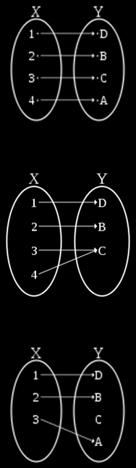
Hash function
Hash function is used to convert
Value’s key → Array’s index
For example, f(8011171234567) = 3
8011171234567 = a person’s register number
3 = an index where the person is stored
f = a hash function
Perfect hash function
Either, if we have an unlimited space
Or, if we have a limited input size
We might have a chance to create a bijective hash function
However, you have to know the characteristic of keys
Good hash function
Hash function resulting in a uniform distribution
Why is this a good hash function?
Why is this difficult?
Pseudo-random….
Any relation to the password encryption algorithm?
Low cost, determinism, variable range….
Bijective Function
Surjective Function
Injective Function

Slide 7
Modulo based hash function
Modulo based hash function
We divide a numeric key with a number
Often, a number = the size of the hash table
We take the remainder as an array index
For example,
Index = Key mod Size
34567 = 8011171234567 mod 50000
But, 34567 = 8011171284567 mod 50000
Why is this often used?
Good variable range
Appears to be uniform
But, actually it is not
Still, surjective function

Slide 8
Square based hash function
Square based hash function
Or, mid-square hash function
The problem of the modulo operation
Under-utilizing available information
Quotient is not used…
Therefore, we perform a mid-square method
First, square the key value
Second, take the N digits in the middle
Third, apply the selected digits to the modulo operation
For example,
Key = 123, Table size = 100, Mid-square digits = 3
f(123) = MidSquare(123) mod 100 = 512 mod 100 = 12
Still utilizing the modulo operation at the end
Why?
123
* 123
-----------
369
246_
123__
-----------
15129
Only affected by the first digit
Only affected by the last digit

Slide 9
Digit analysis based hash function
Digit analysis
A.k.a. checksum hash function
Looks pretty stupid way
But works pretty well
Procedure of the function calculation
One checksum method
First, take all the digits and sum of them
Second, apply the modulo operation to the summation of the digits
For example,
Key = 8011171234567, Table size = 100
f(8011171234567)=(8+0+1+1+1+7+1+2+3+4+5+6+7) mod 100 = 46

Slide 10
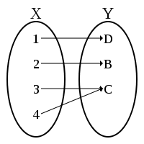
Collision resolution of hashing
Load factor
Load factor is often the determinant of the hash performance
= N / S
N = Size of the stored entries
S = Size of the hash table
Why is this important?
Related to one of the qualities of the hash function, or uniformity
Because of collision
Different keys with the same index
Closed addressing
Open addressing
Surjective Function
Key | Idx | Value
…. | … | ….
Key₁ | 50
…. | … | ….
Collision!
My key is Key2, but my index is 50. My index is already occupied… What to do?

Slide 11
Collision resolution by closed addressing
Collision resolution by closed addressing
Separate chaining
Live together approach
The worst case scenario
Every entries have the same index from a stupid hash function
Just another linked list
Considering the load factor
Load factor > 1 is possible
This case means that every index has one or more entries
Then? Only use the linked list for each bucket? Trees can be used as well…
Idx | Head of a Linked List
… | ….
50
… | ….
Okay. I will pass you whenever I go in and out
Put yourself at my tail

Slide 12

Collision resolution in open addressing
Collision resolution by open addressing
Resolution by probing
See where an empty bucket is
I don’t want to live with you, so get out and find your own place approach
Various probing
Linear probing – see whether the next bucket is empty or not
Index = ( f(Key) + i ) mod S
Quadratic probing
Index = ( f(Key) + i + i² ) mod S
i = number of trials
S = size of the hash table
Why quadratic probing?
Uniformity of a hash function
Because of a cluster
Linear probing: Okay… I will go to the next bucket
Key | Idx | Value
…. | … | ….
f(Key₁)=50 | 50
f(Key₂)=50 | 51 | Empty
…. | …. | ….
…. | …. | ….
…. | …. | ….
f(Key₂)=50 | 99 | Empty
…. | …. | ….
Quadratic probing: Okay… I will go to a bucket far away…

Slide 13
Deletion in open addressing hash table
Deletion
Closed addressing
Simple
Go to the bucket, and follow the linked list, and delete it
Open addressing
Complicated
Intuitively…
Visit the index from the hash function
If it is there, delete it
If not, keep following the probing method, find and delete it
What is wrong with this idea?
Problem scenario?
Insert an 1, 6, 11 with the same index from hash functions, resolved by linear probing
Deleting 6
And, searching 11 ← Problem!
Then?
Lazy deletion
You just mark it and do not delete it
Keep adding entries and no deletion
Why? Cheap storage cost
But, always there is a limit
f(K) = K mod 5
Open addressing
Linear probing
0 | 1 | 2 | 3 | 4
 | 1 | 6 | 11
Delete 6
0 | 1 | 2 | 3 | 4
 | 1 |  | 11
Search 11
0 | 1 | 2 | 3 | 4
 | 1 |  | 11

Slide 14
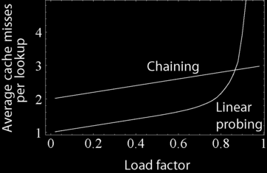
Managing the hash table size
There is always a limit
Even though the storage is cheap
You don’t have an infinite storage
If you don’t delete entries
Keep adding more entries
Then, the table’s load factor becomes higher
What this mean?
More probing to insert
Hence, sometimes
You need to extend the storage space
And insert the entries to the new space with more buckets

Slide 15
Performance of hash table
 | Linked List | Stack | Queue | Binary Search Tree in Average Case | Binary Heap | Hash Table in Average Case
Search | O(N) |  |  | O(logN) |  | O(1)
Insert | O(1) | O(1) | O(1) | O(logN) | O(logN) | O(1)
Delete | O(1) | O(1) | O(1) | O(logN) | O(logN) | O(1)
Type | Linked List Based |  |  | Tree Based |  | Hash Based
Major Paradigm | Linked list, chaining, referencing |  |  | Divide and conquer |  | Array and key
No silver bullet, always pros and cons
Some smart ideas that works in an average case
But, in the extreme case, most of them works similarly….

Slide 16
Further Reading
Introductions to Algorithms by Cormen et al.
pp. 221-252

